Slide 1


||JAI SRI GURUDEV|| ADICHUNCHANAGIRI UNIVERSITY Faculty of Engineering, Management and Technology BGS INSTITUTE OF TECHNOLOGY BG Nagara – 571448, Nagamangala Taluk, Mandya District, Karnataka (INDIA) Department of Information Science And Engineering
An Internship Presentation
On
“Health Monitoring”
Under the guidance of:
Mr. Sridhara N
Assistant Professor, Dept. of ISE,
BGSIT, BG Nagar, Mandya
Submitted by:
Puneeth gowda Y S
21ISE041
8th SEM ISE
Coordinator :
Mr. YOGAPRAKSH M G,
Asst. Professor, Dept. of IS&E,
BGSIT, BG Nagara, Mandya

Slide 2
Contents
Introduction
Objectives of the Internship
About the Company
Vision And Goals
Internship Impact
Architecture
Data Collection
Snapshots
Conclusion
Reference

Slide 3
Introduction
Machine learning is one of the most exciting technologies in today’s world. It has become an integral part of various industries such as finance, healthcare, automotive, etc. In particular, in the healthcare sector, machine learning is revolutionizing the way we monitor and manage health.
With the increasing availability of wearable devices and health-related sensors, there is a large amount of real-time data available, which can be analyzed using machine learning techniques to monitor a patient’s health, predict possible diseases, and assist doctors in making informed decisions.

Slide 4
Objectives of the Internship
To understand and apply machine learning techniques in the field of healthcare.
To collect and preprocess health-related data for analysis.
To develop a system for monitoring patient health using real-time data.
To build predictive models that can detect early signs of health issues.
To assist healthcare professionals by providing data-driven insights.

Slide 5

About The Company
Company Name : Technofly Solutions
Reregister Address: Technofly Solutions Pvt Ltd, #778, 2nd Floor, Vijaynagar, BangaloreKarnataka 560040
Official Website: www.tecnofly.in
TechnoFly Solutions is a best-in-class learning solutions organization headquartered in India’s IT capital, Bangalore. We offer a wide range of courses in the area of software testing and software development
It was founded on 2017. At TechnoFly Solutions , They ensure training is imparted by specialists with proven subject matter expertise and who have spent over a decade in their area of specialization.

Slide 6
Vision And Goals
Gain Practical Experience: Use the internship as an opportunity to apply theoretical knowledge to real-world scenarios and projects.
Learn Industry Best Practices: Understand how professionals in our field operate, including their workflows, tools, and methodologies.
Build Professional Relationships: Network with industry professionals, mentors, and fellow interns to expand your professional circle.
Explore Career Paths: Use the internship to explore different roles and industries within your field of study or interest

Slide 7
Internship Impact
Technical Growth:
Improved skills in HTML, CSS, and Python
Practical Learning:
Learned to design and develop a fully offline working system
Experienced real-time problem solving during debugging
Professional Development:
Gained exposure to working in a project-based environment
Improved time management and independent working skills

Slide 8
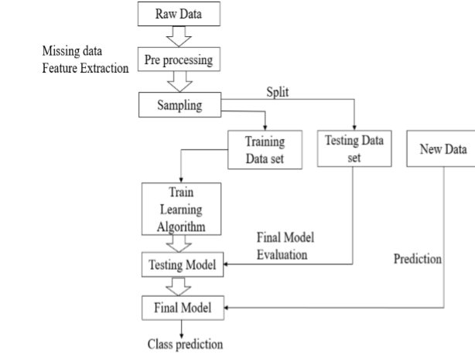
ARCHITECTURE

Slide 9
Data collection
The dataset used in this study consisted of 700 records collected from asthma patients using previously prescribed home telemanagement.52 The severity of asthma varied from mild persistent to severe persistent.31 Patients used a laptop computer at home to fill in their asthma diary on a daily basis.
The diary included information about respiratory symptoms, sleep disturbances due to asthma, limitation of physical activity, presence of cold, and medication usage (Table 1).
The laptop sent the results of patient self-testing to a central server on a daily basis.

Slide 10
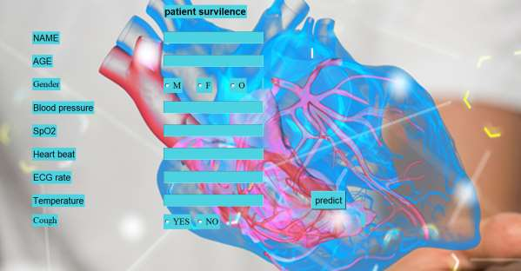
SNAPSHOTS
Fig:User interface
healthcare application for predicting patient health based on various medical parameters like age, gender, blood pressure, heart rate, ECG rate, Users input these values

Slide 11
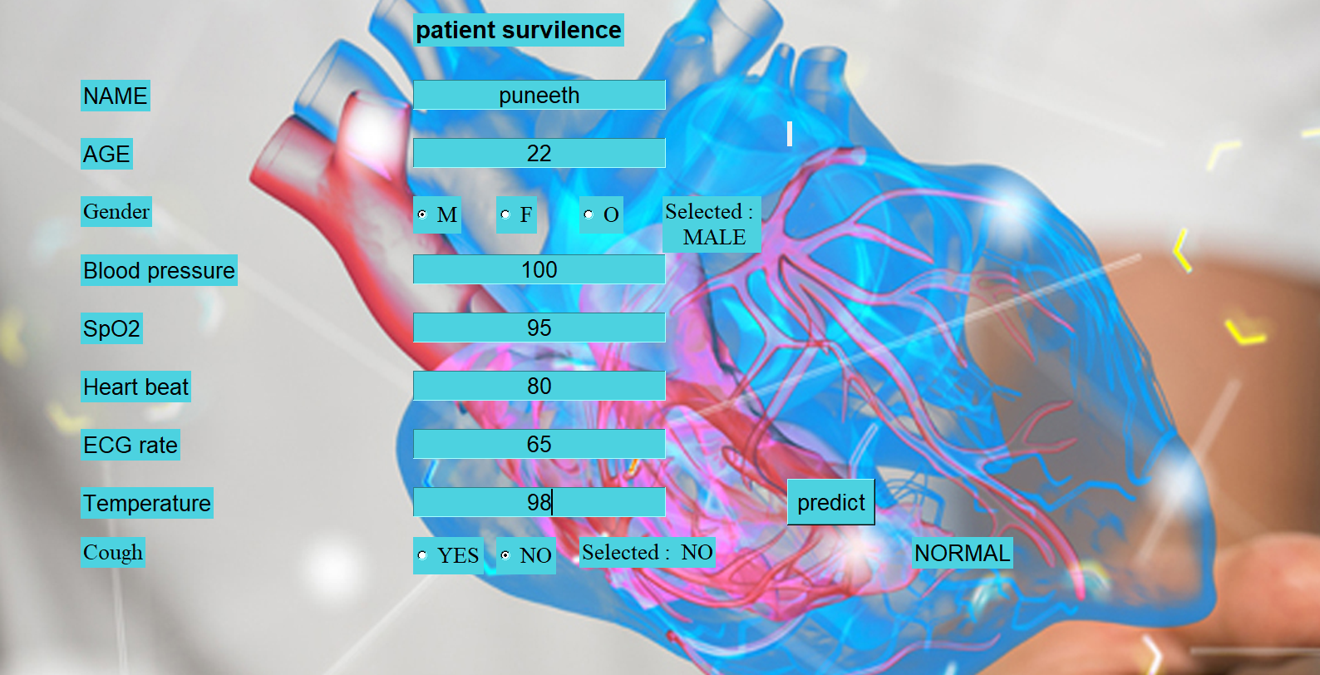
SNAPSHOTS
Fig: Prediction interface normal
This prediction interface collects a patient's vital signs and symptoms to assess their health status. After inputting the details and clicking "predict," it provides a result—like "NORMAL"—indicating the patient's current health condition.

Slide 12
Conclusion
Machine learning has strong potential for predicting general health conditions in patients.
Future models will use multiple data sources (e.g., wearables, medical records, test results) to improve accuracy.
Feature selection, data preparation, and algorithm optimization will further enhance prediction quality.
Predictive modeling can be extended to specific diseases like diabetes, heart problems, etc.
Overall, ML-based health systems can enable early detection, preventive care, and better healthcare outcomes.

Slide 13
References
[1].Alvee Rahman Department ,Tahsinur Rahman and Nawab Haider Ghani ,”Iot Based Patient Monitoring System using ECG Sensor” in 2019 International Conference on Robotic,Electrical and Signal Processing Techniques(ICREST-2019).
[2].Dr.T.J.Swamy and Mr.T.N.Murthy,”eSmart:An Iot based Intelligent Health Monitoring and Management System for Mankind” ,2019 International Conference on Computer Communication and Information (ICCCI-2019),Jan 23-25 ,Coimbatore,India.
[3].Gulam Gaus Warsi,Kanchan Hans,Sunil Kumar Khatri from Amity Institute Of Information Technology ,in the 2019 International Conference on Machine Learning Big Data ,Cloud and Parallel Computing(Com -IT-Con),India,14th-16th Feb 2019.
[4].Mohammed Sala Uddin Jannat Binata Alam and Suraiya Banu ,”Real Time Patient Monitoring System Based on Internet of Things” ,Proceedings of the 2017 4th International Conference on Advances in Electrical Engineering (ICAEE)28-30 September,Dhaka,Bangladesh.

Slide 14
THANK YOU

